Slide 1
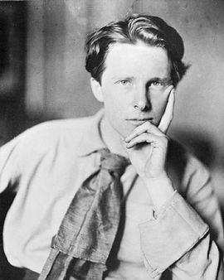
Rupert Chawner Brooke 1887 - 1915

Slide 2
Success
I THINK if you had loved me when I wanted;
If I’d looked up one day, and seen your eyes,
And found my wild sick blasphemous prayer granted,
And your brown face, that’s full of pity and wise,
Flushed suddenly; the white godhead in new fear
Intolerably so struggling, and so shamed;
Most holy and far, if you’d come all too near,
If earth had seen Earth’s lordliest wild limbs tamed,
Shaken, and trapped, and shivering, for My touch—
Myself should I have slain? or that foul you?
But this the strange gods, who had given so much,
To have seen and known you, this they might not do.
One last shame’s spared me, one black word’s unspoken;
And I’m alone; and you have not awoken.

Slide 3
The Soldier
If I should die, think only this of me: That there's some corner of a foreign field That is for ever England. There shall be In that rich earth a richer dust concealed; A dust whom England bore, shaped, made aware, Gave, once, her flowers to love, her ways to roam, A body of England's, breathing English air, Washed by the rivers, blest by suns of home. And think, this heart, all evil shed away, A pulse in the eternal mind, no less Gives somewhere back the thoughts by England given; Her sights and sounds; dreams happy as her day; And laughter, learnt of friends; and gentleness, In hearts at peace, under an English heaven.

Slide 4
A Song
As the Wind, and as the Wind,
In a corner of the way,
Goes stepping, stands twirling,
Invisibly, comes whirling,
Bows before, and skips behind,
In a grave, an endless play—
So my Heart, and so my Heart,
Following where your feet have gone,
Stirs dust of old dreams there;
He turns a toe; he gleams there,
Treading you a dance apart.
But you see not. You pass on.

