Slide 1
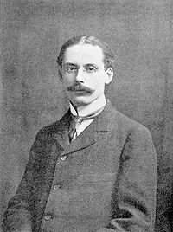
Edwin Arlington Robinson (1869 - 1935)

Slide 2
Richard Cory
Whenever Richard Cory went down town,
We people on the pavement looked at him:
He was a gentleman from sole to crown,
Clean-favoured and imperially slim.
And he was always quietly arrayed,
And he was always human when he talked;
But still he fluttered pulses when he said,
"Good Morning!" and he glittered when he walked.
And he was rich, yes, richer than a king,
And admirably schooled in every grace:
In fine -- we thought that he was everything
To make us wish that we were in his place.
So on we worked and waited for the light,
And went without the meat and cursed the bread,
And Richard Cory, one calm summer night,
Went home and put a bullet in his head.

Slide 3
Walt Whitman
The master-songs are ended, and the man
That sang them is a name. And so is God
A name; and so is love, and life, and death,
And everything. But we, who are too blind
To read what we have written, or what faith
Has written for us, do not understand:
We only blink, and wonder.
Last night it was the song that was the man,
But now it is the man that is the song.
We do not hear him very much to-day:
His piercing and eternal cadence rings
Too pure for us — too powerfully pure,
Too lovingly triumphant, and too large;
But there are some that hear him, and they know
That he shall sing to-morrow for all men,
And that all time shall listen.
The master-songs are ended? Rather say
No songs are ended that are ever sung,
And that no names are dead names.
When we write Men’s letters on proud marble or on sand,
We write them there forever.

