Slide 1
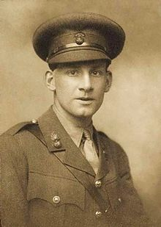
Siegfried Loraine Sassoon 1886 - 1967

Slide 2
SUICIDE IN THE TRENCHES
I knew a simple soldier boy Who grinned at life in empty joy, Slept soundly through the lonesome dark, And whistled early with the lark.
In winter trenches, cowed and glum, With crumps and lice and lack of rum, He put a bullet through his brain. No one spoke of him again.
You smug-faced crowds with kindling eye Who cheer when soldier lads march by, Sneak home and pray you'll never know The hell where youth and laughter go.

